Slide 1
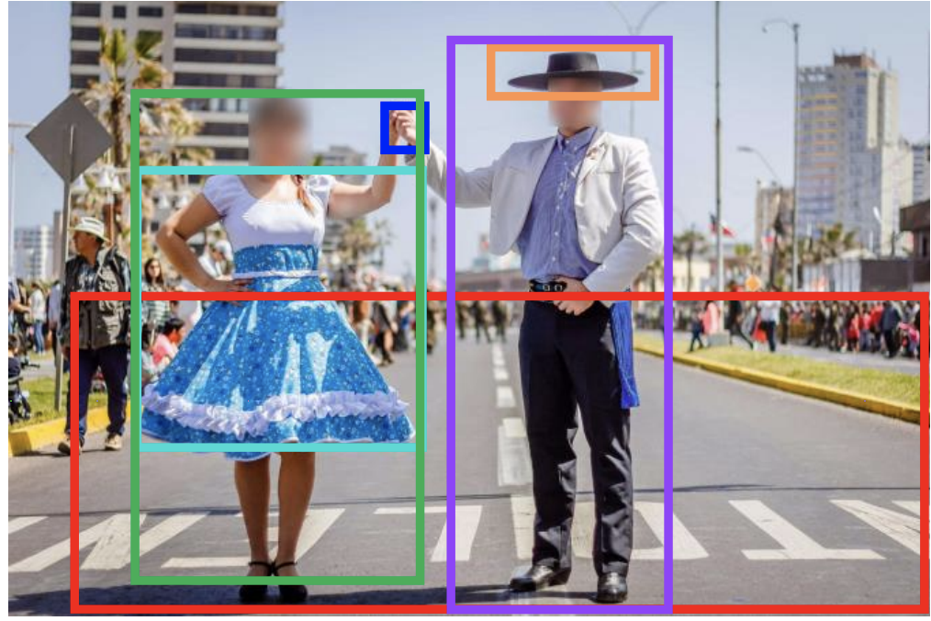
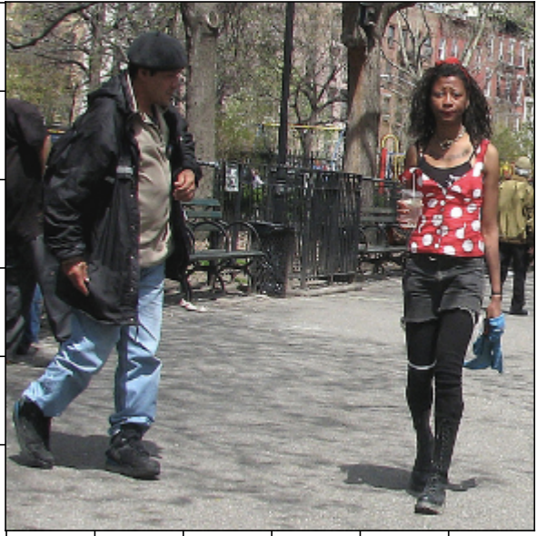
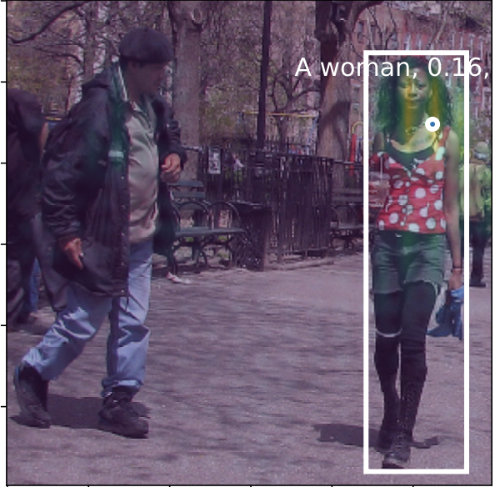
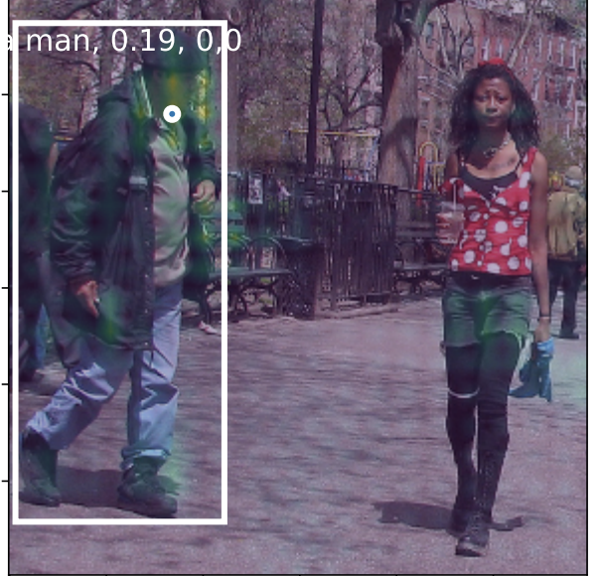
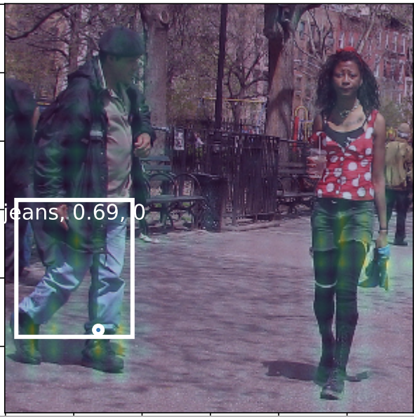
Multi-Modal common semantic space for Image-Phrase Grounding
Sonam Goenka, Hassan Akbari
Advanced Computer Vision Course, Columbia University
INTRODUCTION
MODEL ARCHITECTURE
EXPERIMENTS AND RESULTS
Objective: Learn a common semantic space shared between textual and visual modalities using unsupervised learning and use it to solve various problems such as Image Phrase Grounding and Visual Question Answering.
Image Phrase Grounding is the task of localizing within an image a given natural language input phrase.
Input S: Sentence of T words
Elmo
T word
embeddings
Linear combination
FC Layer (2X)
(word)
We trained our model on MSCOCO dataset and report results on the test-dev dataset as part of the VQA2.0 challenge. The current architecture did not scale that well to VQA
BiLSTM1
Linear combination
FC Layer (2X)
(sentence)
Textual representation
 | Overall | Other | Number | Yes/No
State of the art | 66.72 | 56.77 | 46.65 | 83.70
Our Model | 54.59 | 44.89 | 36.5 | 70.76
BiLSTM2
Cosine similarity/RelLU
VQA
Results
A young lady in blue skirt and a man with a black hat are holding hands in the middle of a road.
Upsample
and Concat
3x3 Conv
Heat map (common semantic space)
Visual representation
Visual representation
Visual Question Answering is the task of answering natural language questions about an image.
Image passed through CNN generating an Image Pyramid
Common semantic space computation
QUALITATIVE RESULTS
What sport is being played?
Are there any humans?
How many players are in the image?
Is it raining?
Visual representation
Textual representation
Masking
Cosine similarity
Grounding Loss
APPROACH
Heat map (common semantic space)
Attended
visual representation
Visual representation
Textual representation
We started with the base model developed by Akbari et al. which uses Multi-Modal attention mechanisms to learn a common semantic space using unsupervised learning. We tried to understand, improve and extend the model in the following ways
Analyze relative contribution of CNN layers: We analyzed which layers of the CNN (and their corresponding feature maps) correlate with different categories of words or phrases.
Generate better visual representation: In order to extract more localized information from the CNN layers, we experimented with larger convolution layers while creating the visual representation. We also experimented with changing how we combined features from the different CNN layers by not selecting one layer but instead took an Image Pyramid approach and up-sampled and concatenated the features
Leverage supervised image segmentation data: We utilized the instant segmentation data available in the MSCOCO dataset to add an additional supervised loss to the model. For this, we generated a heatmap for each category present in the image which we treated as probability predictions for the segmentation mask.
Furthermore, we extended the model to perform the task of Visual Question answering by
Fusing the attended visual and textual representations and passing through multiple dense layers
Treated the output of the final FC layer as a distribution over likely answers.
Added our own Bi-LSTM layer to obtain contextualized sentence embeddings instead of using the ELMo ones.
Masking
Fusion
FC layer
Sigmoid
VQA Loss
Cross entropy
Segmentation Loss
Heat map (common semantic space)
Attended
visual representation
Answer probabilities
VQA Model
A woman in a polka-dot shirt and black boots is walking down the street and being approached by a man in a black jacket and jeans
Heat map (common semantic space)
Phrase grounding model
EXPERIMENTS AND RESULTS
Our visual model was VGG network, we trained on Visual Genome Data and tested on Visual Genome, Flickr30 and Refer it dataset.
Level selection analysis:
It seems the last layer was selected most of the time for sentence as it contains the most semantic information.
For common verbs, the middle layer was selected. Second layer was hardly selected
Better Visual Extraction:
Using 3x3 convolutions to extract more fine-grained information and using pyramid architecture to combine the information significantly improves the result
Segmentation Branch:
Using supervision from segmentation task improves model to perform better on grounding task
CONCLUSIONS
Pointing Game Hit Accuracy | Visual Genome | Flickr30k | ReferIt
Baseline model | 48.76 | 60.08 | 60.01
Larger convolution (3 x 3 conv) | 50.4 | 67.27 | 62.07
Pyramid Architecture | 54.1 | 67.90 | 62.3
Segmentation Loss | 55.3 | 68.4 | 64.3
- Extracting better visual features can improve grounding models
- Leveraging supervision from task like segmentation can help model in understanding concepts better
- For task like VQA we need to further improve the model by using better attention mechanism
Image Grounding Results

